Slide 1

Community Needs Assessment
Disclaimer: There is known sampling bias within this data due to the nature of how the survey was distributed (online via Survey Monkey). Please keep that in mind when reviewing.

Slide 2
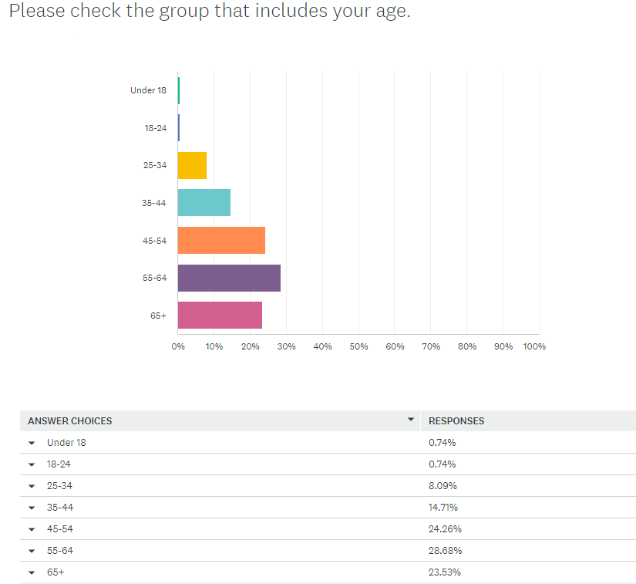
Survey results

Slide 3
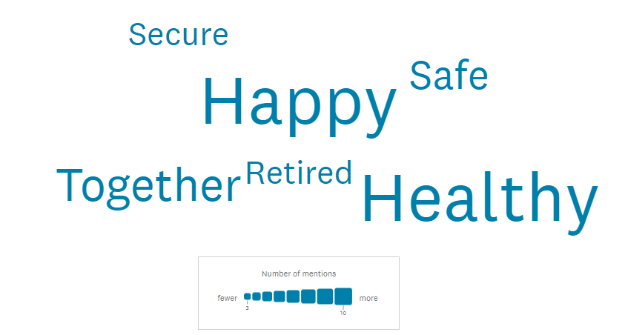
Survey results
Imagine 25 years from now. Share one (1) word that represents your hopes for what your family will be then.

Slide 4
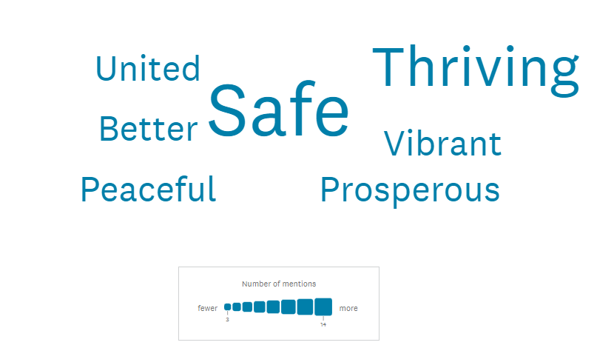
Survey results
What about your community?

Slide 5
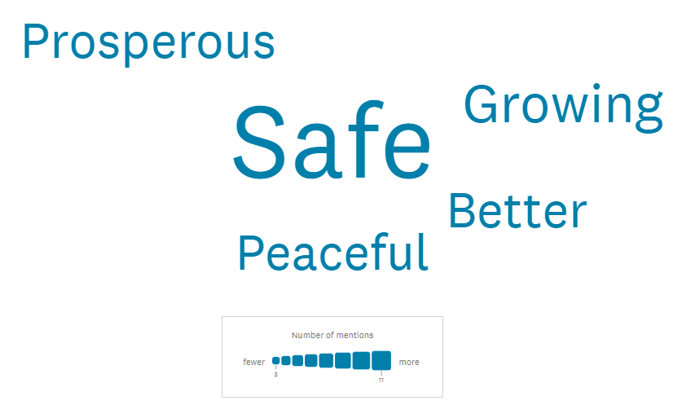
Survey results
Our region?

Slide 6
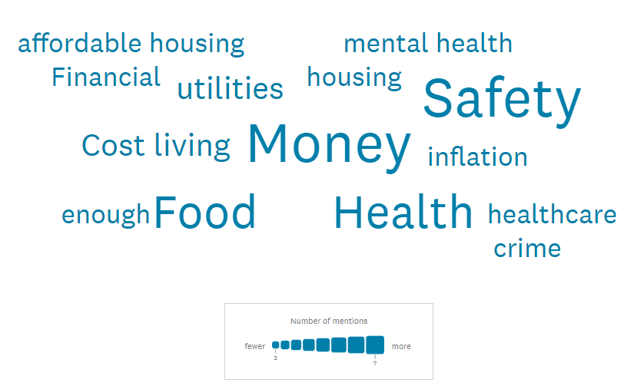
Survey results
What, if anything, do you worry about the most for you or your family/household?

Slide 7
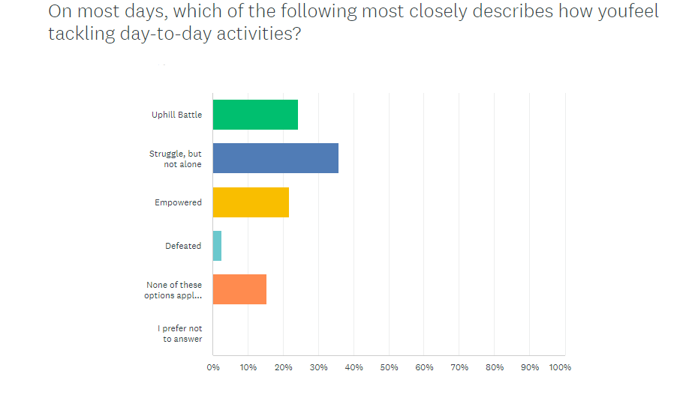
Survey results

Slide 8
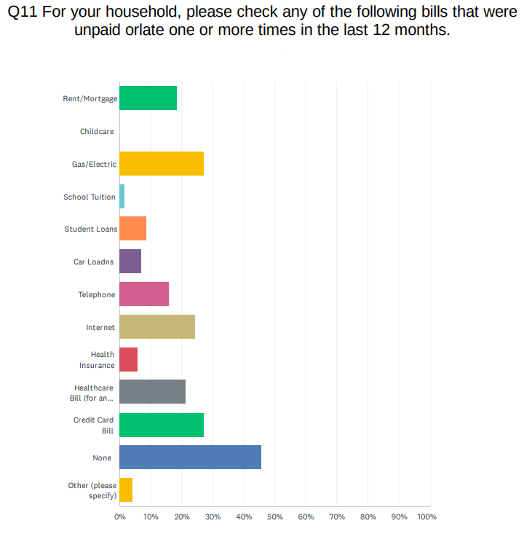
Survey results

Slide 9
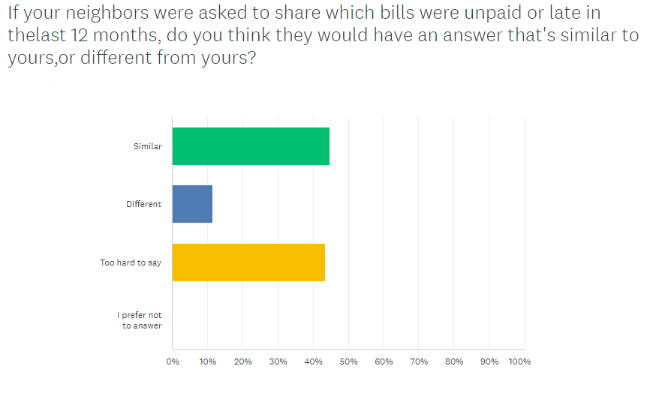
Survey results

Slide 10
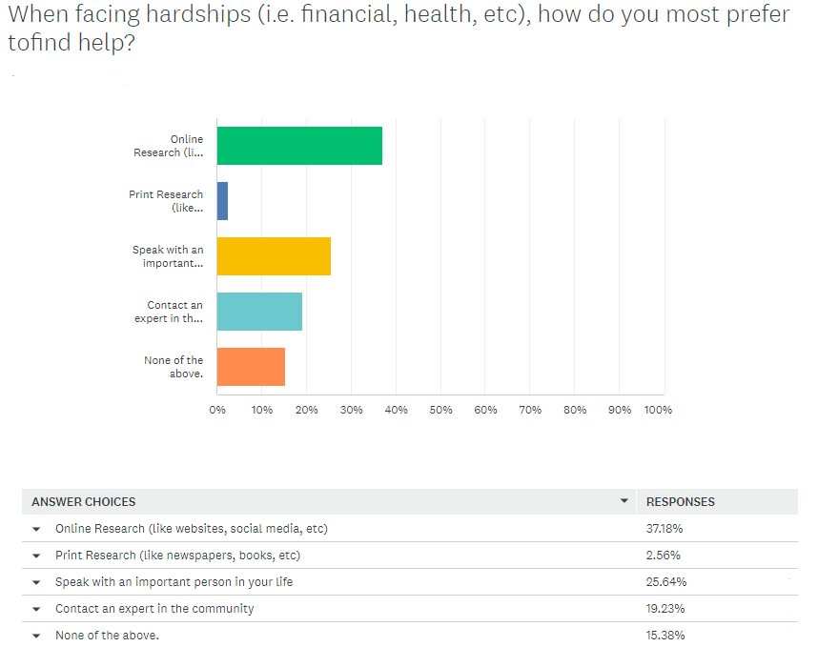
Survey results

Slide 11
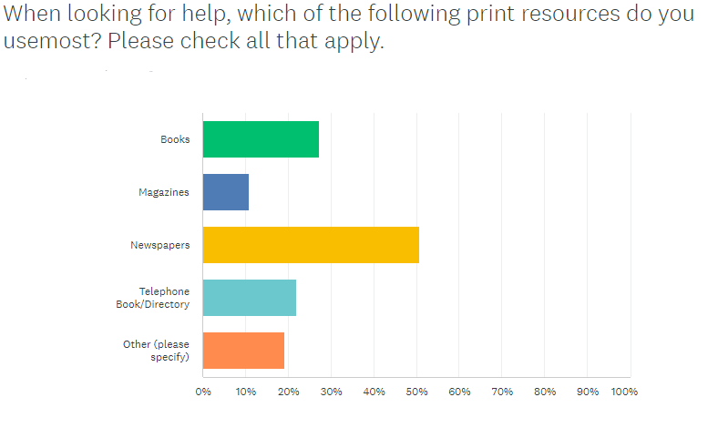
Survey results

Slide 12
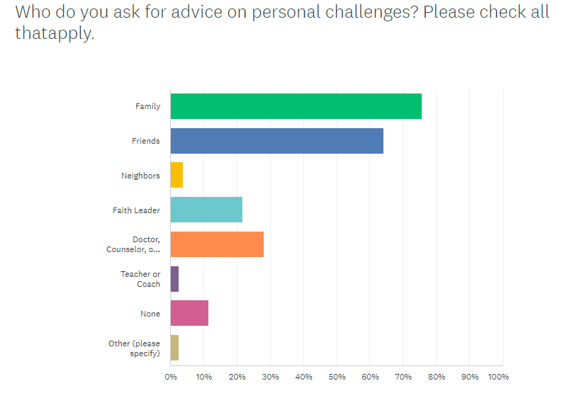
Survey results

Slide 13
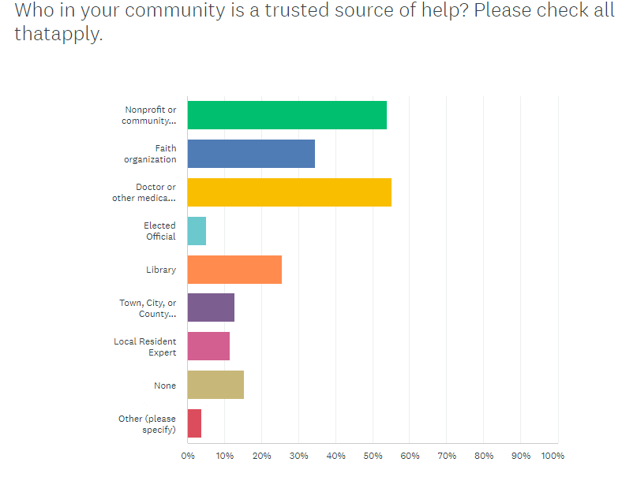
Survey results

Slide 14
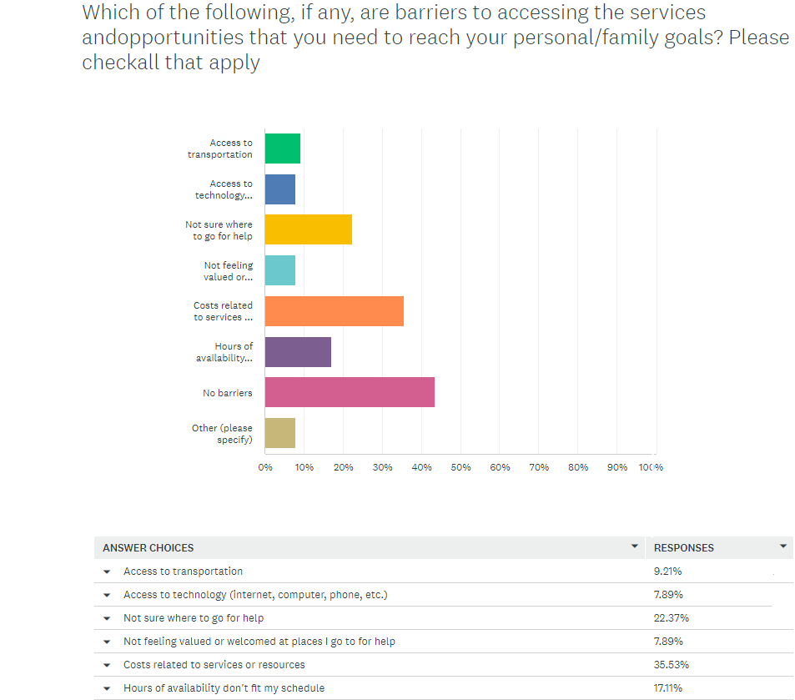
Survey results

Slide 15
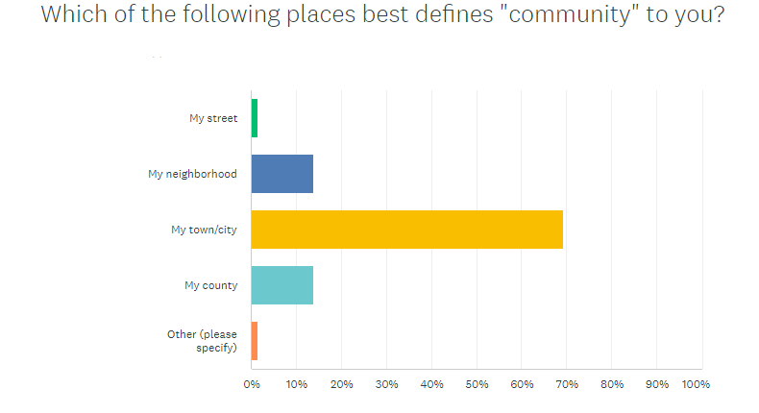
Survey results

Slide 16
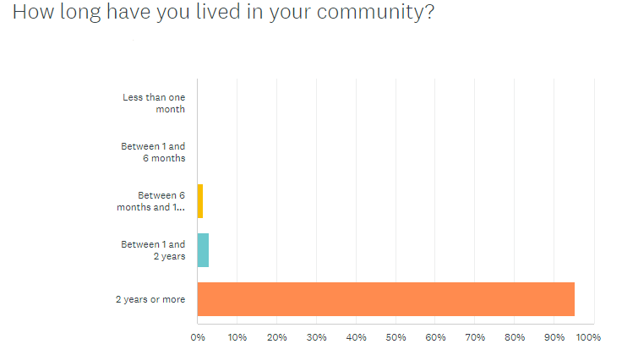
Survey results

Slide 17
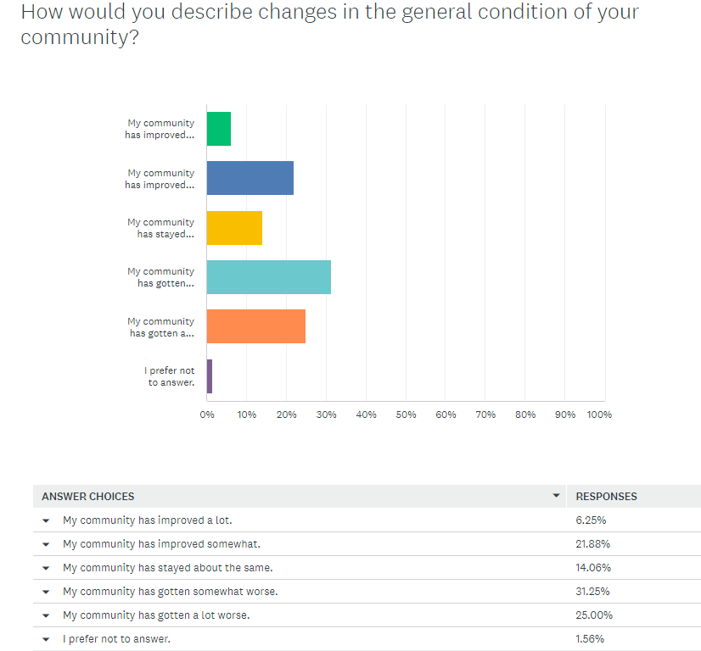
Survey results

Slide 18
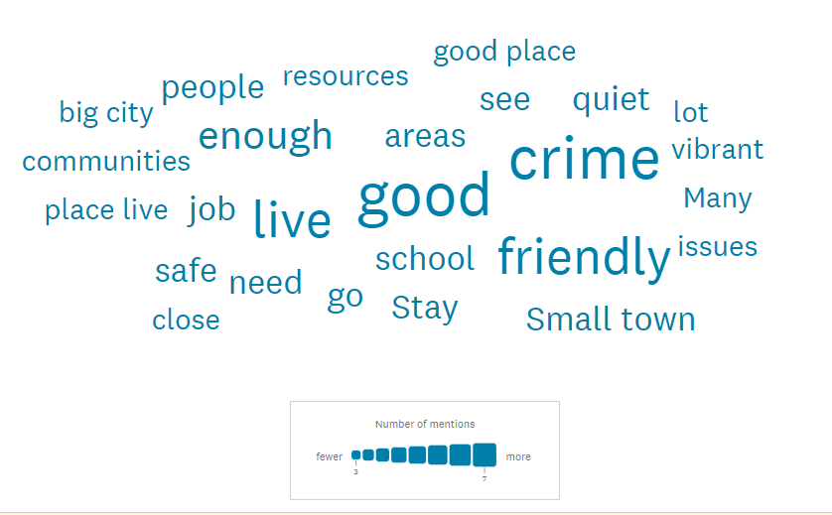
Survey results
How would you describe your community to someone who was considering moving there?

Slide 19
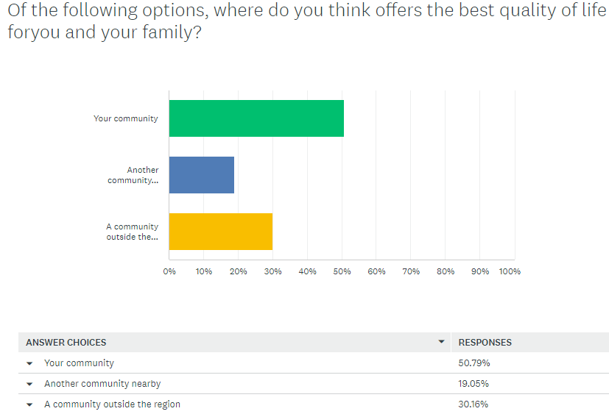
Survey results

Slide 20
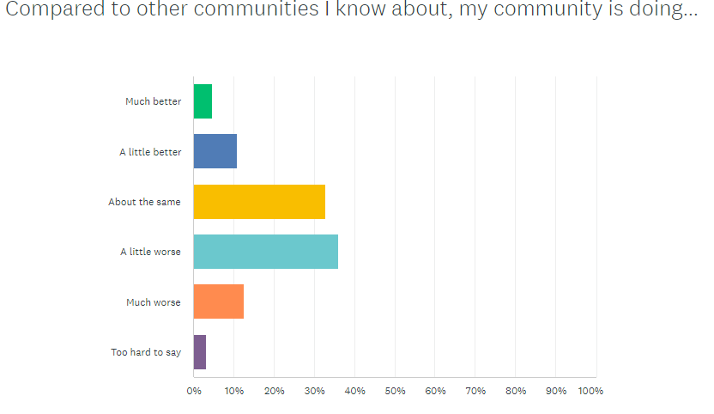
Survey results

Slide 21
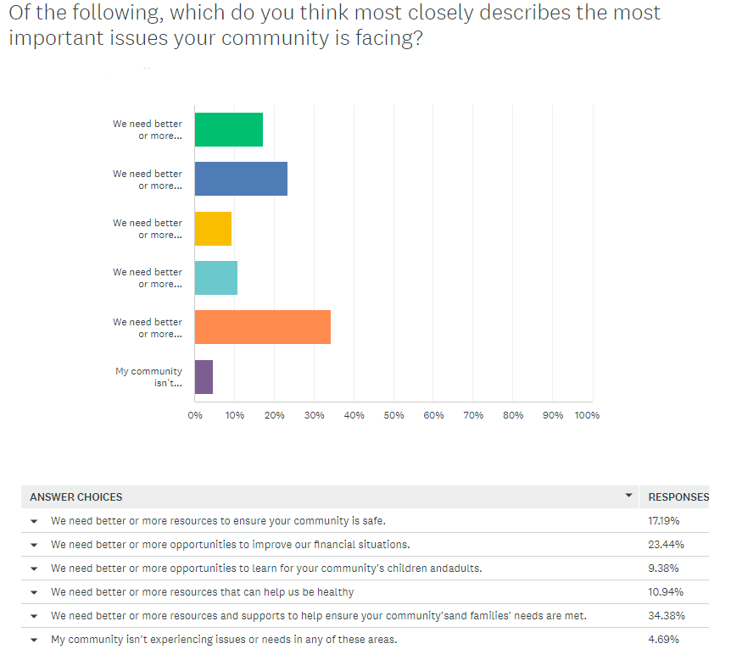
Survey results

Slide 22
Survey results
Please rank the following services and supports from the most needed (#1) to least needed in your community.
Services that improve public safety and reduce crime.
Safe havens and shelters for those experiencing violence.
Programs focused on domestic violence prevention and support.
Responders and services that help when a natural disaster hits.

Slide 23
Survey results
Please rank the following education services and programs from the most needed (#1) to least needed in your community.
Daycare
Life skills programs for teens and adults
K-12 Education
After-School and Enrichment Programs
Early Childhood Education (Pre-K)
Programs for Adults who want to Finish High School
Adoption & Foster Care
Tutoring and Testing Help
Education Opportunities for Adults who have already Graduated from High School

Slide 24
Survey results
Please rank the following health-related services and programs from the most needed (#1) to least needed in your community
Counseling services that help support community members' mental health
Programs and services for community members seeking treatment for/recovery from addiction and drug abuse
Resources that help community members maintain and improve their physical health
Healthcare providers, facilities, and clinics
Resources for people with disabilities

Slide 25
Survey results
Please rank the following resources from the most needed (#1) to least needed in your community
Affordable Housing
Temporary Housing & Shelters
Healthy Food
Community-based organization Collaboration
Crisis Intervention & Prevention Services
Advocacy and Education on services available
Clothing
Individual Volunteer Opportunities
Improvements to city – Roads, Parks, Etc.
Legal Assistance
Social Services for Seniors
Transportation Options

Slide 26
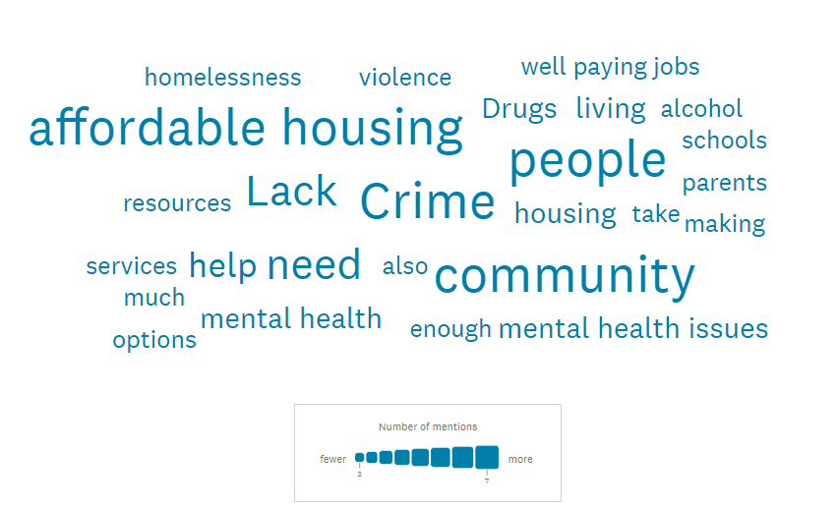
Survey results
Please describe the biggest issue you feel your community is facing.

Slide 27
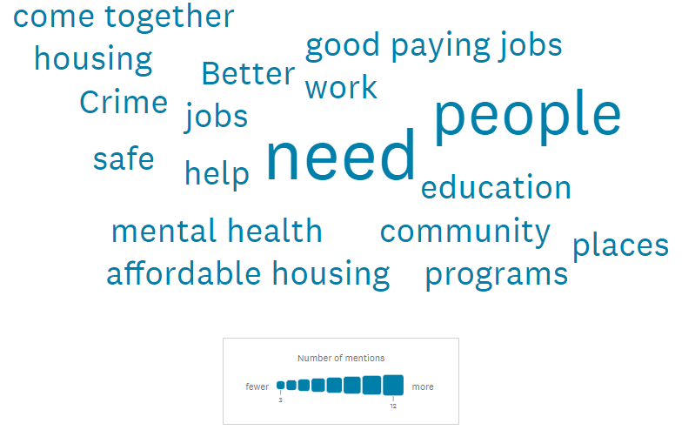
Survey results
What do you believe needs to change today for everyone in your community to thrive?

Slide 28
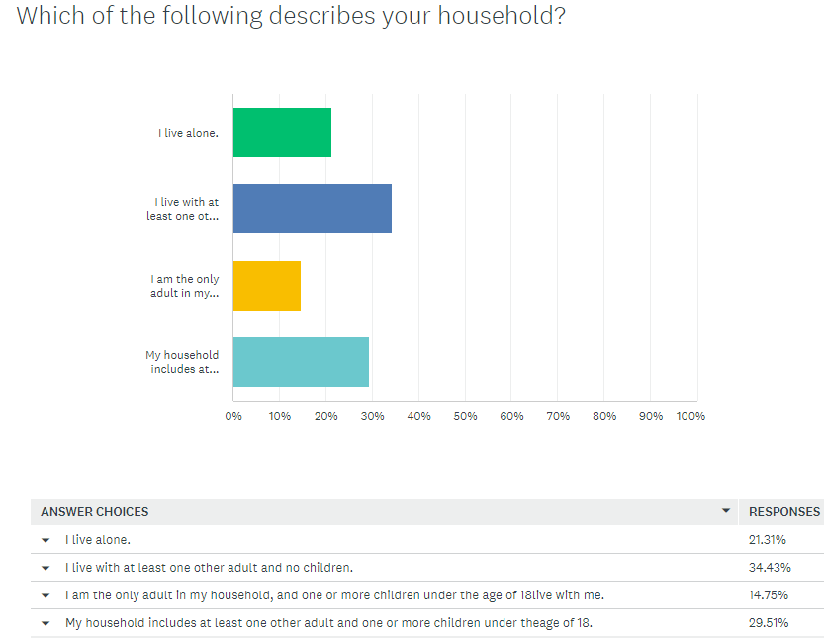
Survey results

Slide 29
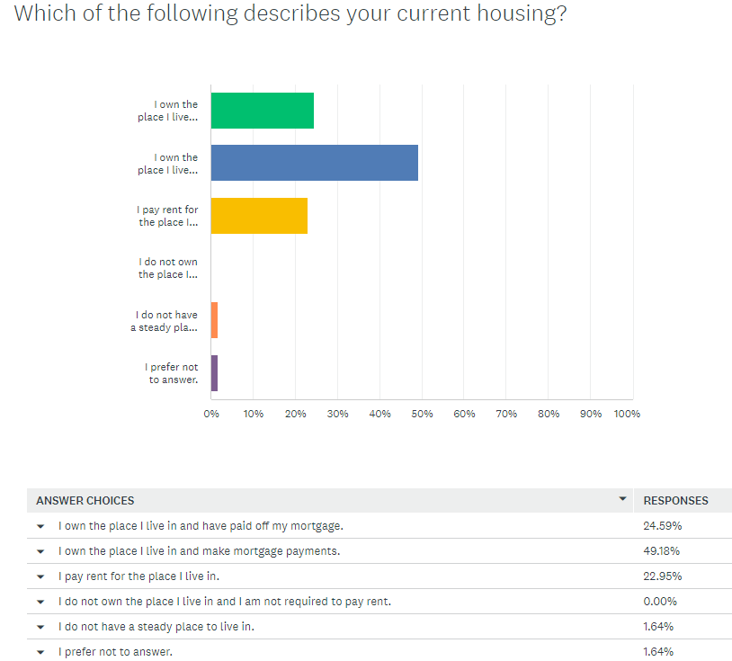
Survey results

Slide 30
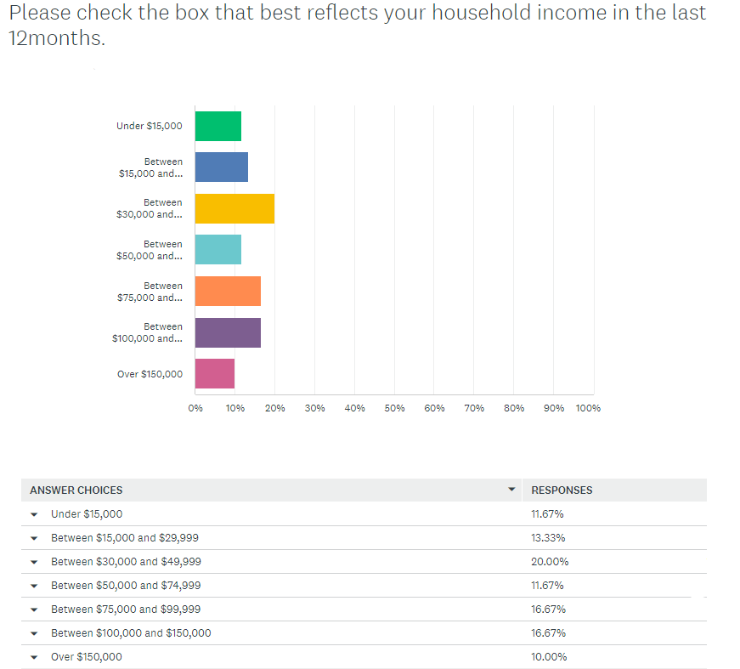
Survey results

Slide 31
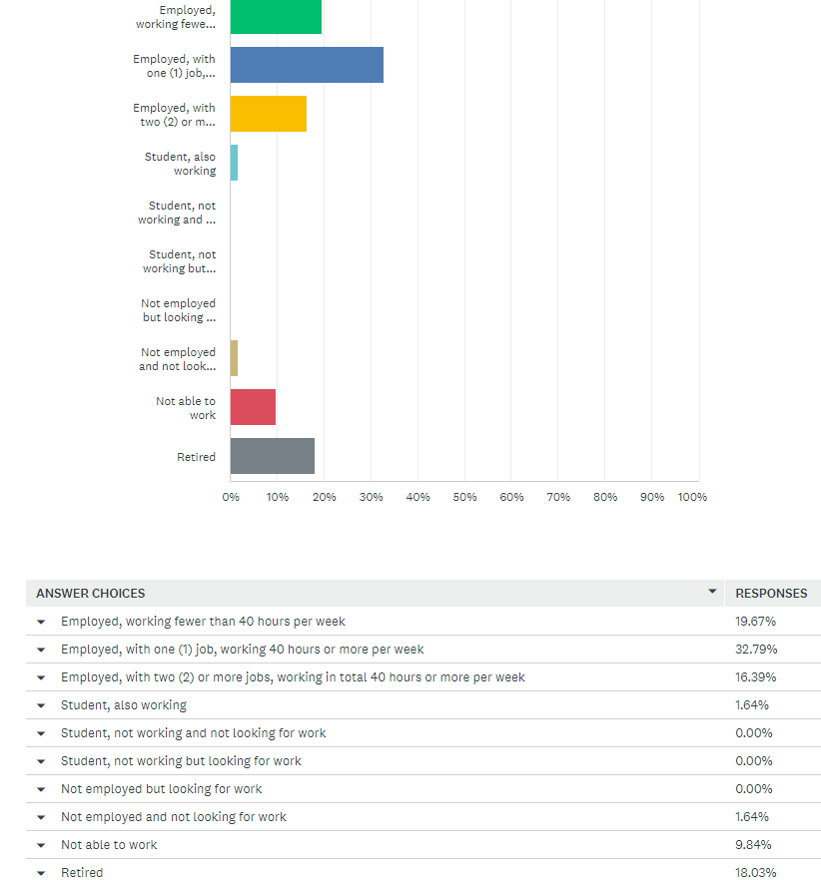
Survey results

Slide 32
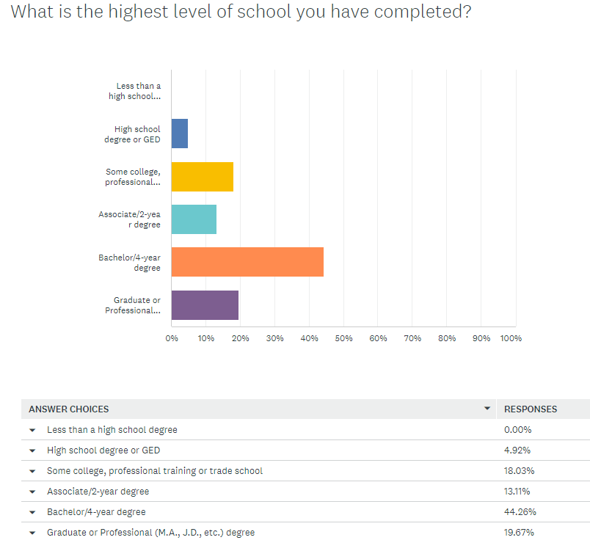
Survey results

Slide 33
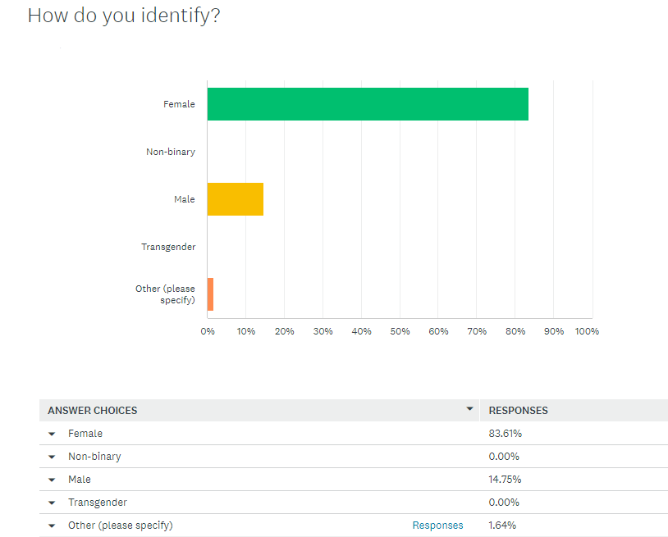
Survey results

Slide 34
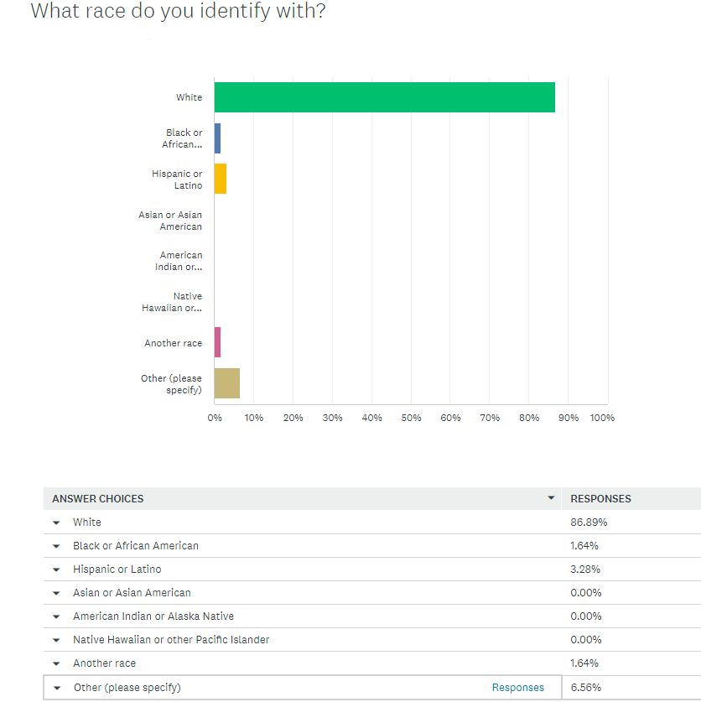
Survey results

